Slide 1
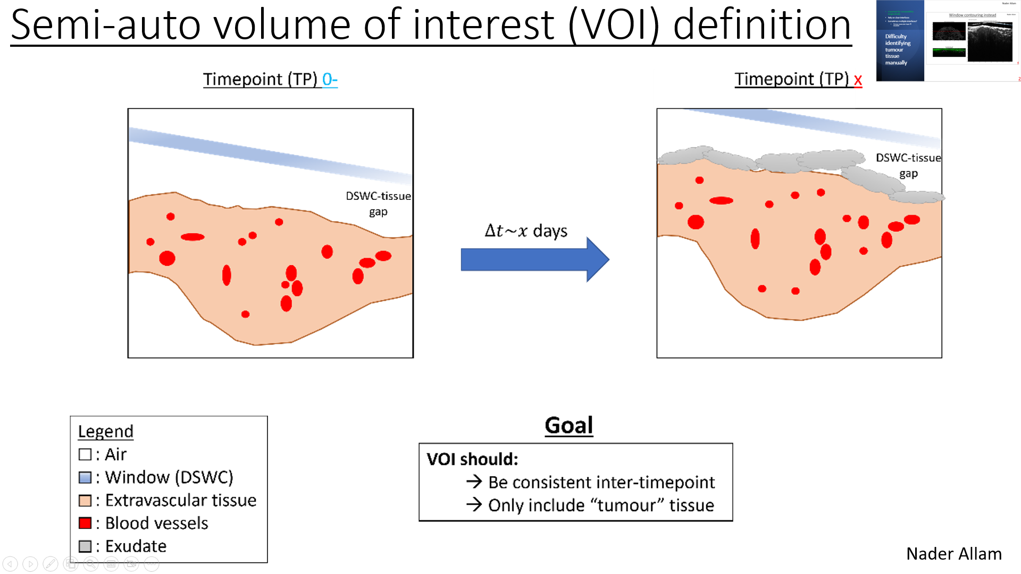
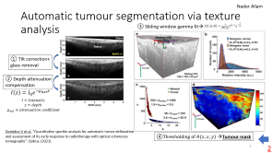
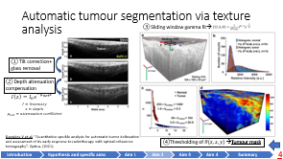
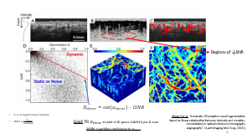
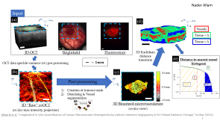
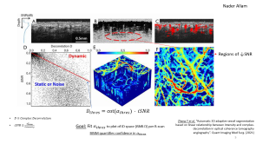
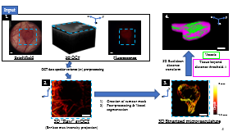
Computation of vascular metrics longitudinally rely on multiple factors
Nader Allam
Accuracy and repeatability of:
Vascular segmentation
3D volume of interest definition
Manual
Automatic
Manual – semi-automatic
Automatic
(See Tissue Masking cartoon file)

Slide 2
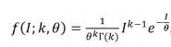
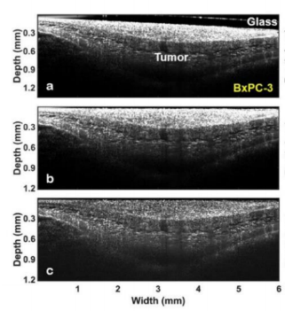
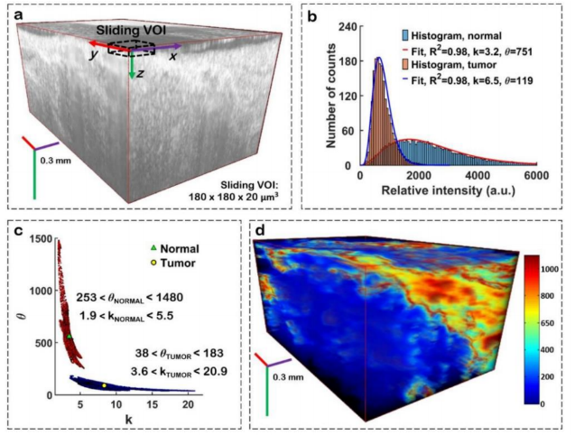
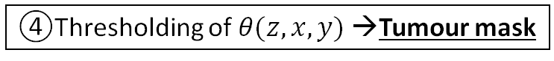
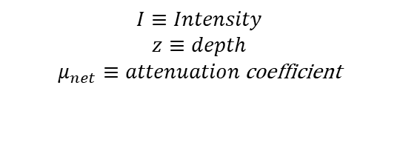
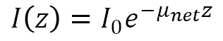
Automatic tumour segmentation via texture analysis
Nader Allam
③ Sliding window gamma fit→
① Tilt correction+ glass removal
② Depth attenuation compensation
$$I\left(z\right)={I_{0}e}^{−μ_{net}z }$$
$$I≡Intensity$$
$$z≡depth$$
$$μ_{net}≡attenuation \text{coefficient}$$
Demidov V et al, “Quantitative speckle analysis for automatic tumor delineation and assessment of its early response to radiotherapy with optical coherence tomography”. Optica. (2021)
④Thresholding of $θ(z,x,y)$ →Tumour mask
2
Notes:
Plot C shows that accurate separation between tumour and surrounding tissue best with theta not k

Slide 3
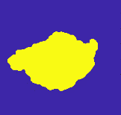
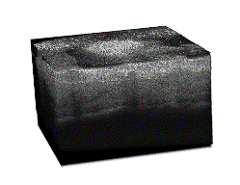
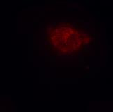
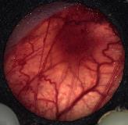
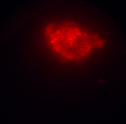
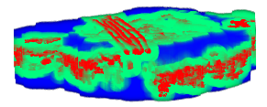
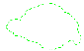
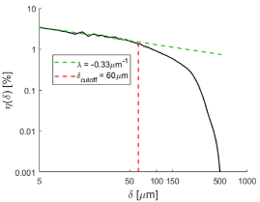
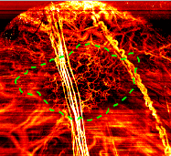
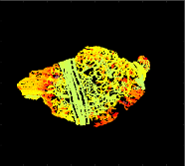
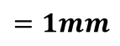

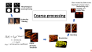
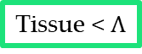

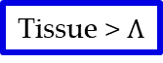
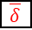
Nader Allam
Input
(a)
y
x
(d)
y
x
-z
-z
Vessels
Tissue < $Λ$
Tissue > $Λ$
3D OCT
Brightfield
Fluorescence
3D Euclidean distance transform
(e)
Distance to nearest vessel histogram
OCT data speckle-variance (sv) pre-processing
$$=1mm$$
λ
(b)
(c)
0.0 mm
y
Post-processing
y
$$\overline{δ}$$
x
x
-0.5 mm
$$VVD$$
DLF₁₅₀
Creation of tumour mask
Denoising & Vessel segmentation
Depth [mm]
-1.0 mm
3D “Raw” svOCT
(en-face max intensity projection)
3D Binarized microvasculature
(en-face view)
Allam N et al, “Longitudinal In-Vivo Quantification of Tumour Microvascular Heterogeneity by Optical Coherence Angiography in Pre-Clinical Radiation Therapy,” Sci Rep. (2022)

Slide 4
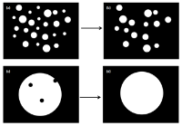
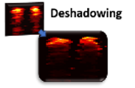
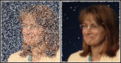
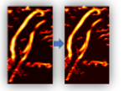
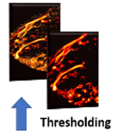
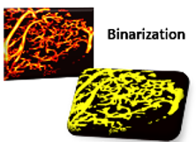
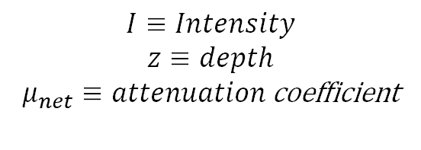
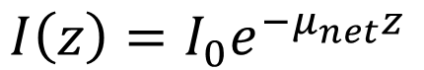
Coarse-processing
Slide created by Blake Jones
Modified by Nader Allam
Morphological opening/closing
Deshadowing then rescaling + 2nd median filter
2D Median filtering
Upscaling
$$I\left(z\right)={I_{0}e}^{−μ_{net}z }$$
Binarization
$$I≡Intensity$$
$$z≡depth$$
$$μ_{net}≡attenuation \text{coefficient}$$
Depth-decaying Threshold
4
Notes:
Can avoid guessing attenuation coefficient by using some value per A-scan– based on known intensity at surface vs intensity at depth and fitting a mu_net for the given A-scan
Small motion such as animal heartbeat can cause artifacts in svOCT images. These artifacts
often manifest as thin, single-pixel-width lines in the B-scan (y) direction. In the x-z plane, they
appear as bright pixels in dark regions (salt noise). These artifacts were eliminated by applying
morphological opening followed by morphological closing in each B-scan in the x-z direction
Morphological operators compare each pixel to the surrounding pixels in the
neighbourhood, where the neighbourhood is defined by the size and shape of a structuring element.
A 2D circular structuring element with a radius of one pixel was used under the assumption that
most vessels have approximately circular cross sections. Morphological opening consists of
erosion (reduction of boundaries of regions of foreground pixels) followed by dilation
(enlargement of boundaries of foreground pixels). This effect of this filter is the removal ‘salt’
noise smaller than the radius of the structuring element, i.e. single bright pixel regions in
background areas, such as the motion artifacts described above. Closing is the complement of
opening (dilation followed by erosion) and is used to eliminate ‘pepper’ noise, for example small
dark pixel regions within a vessel [52]. The use of a disk-shaped structuring element also reduced
some vessel surface irregularities and made the vascular cross sections more circular. A
Upscalling to allow for deshadowing

Slide 5
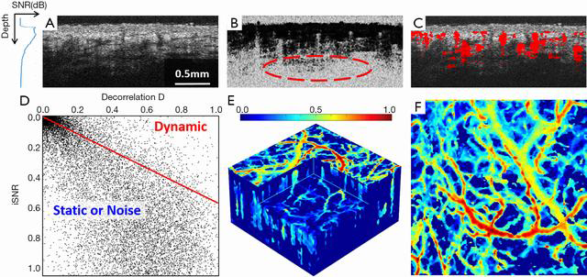
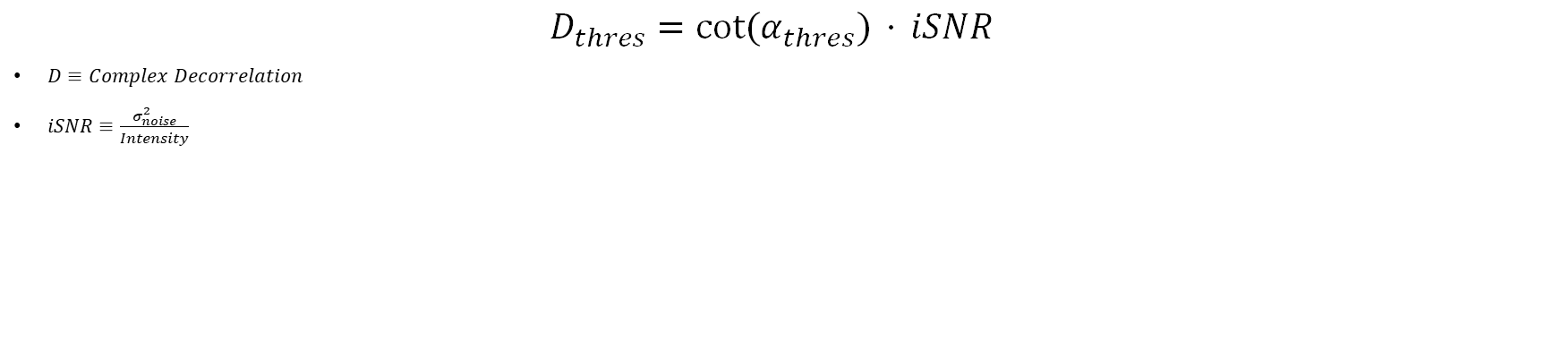
Nader Allam
Regions of ↓SNR
$$D_{thres}=cot⁡(α_{thres}) ⋅ iSNR$$
$D≡Complex Decorrelation$
$iSNR≡\frac{σ_{noise}^{2}}{Intensity}$
Zhang Y et al. “Automatic 3D adaptive vessel segmentation based on linear relationship between intensity and complex-decorrelation in optical coherence tomography angiography”. Quant Imaging Med Surg. (2021)
Goal: Fit $α_{thres}$ to plot of ID space (iSNR-D) per B-scan
BISIM quantifies confidence in $α_{thres}$
Notes:
$a.s.$→ asymptotically (with probability of convergence 1)
$D_{thres}$ is the value of decorrelation vs iSNR considered to be threshold between vessel and non-vessel
$α_{thres}$ is the slope fit
Need small enough VOI to be locally adaptive but also large enough

Slide 6
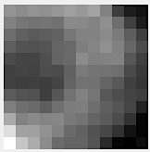
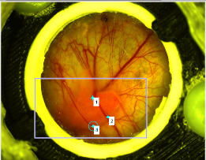
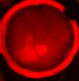
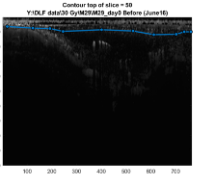
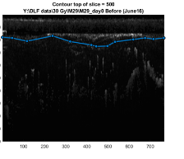
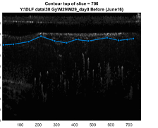
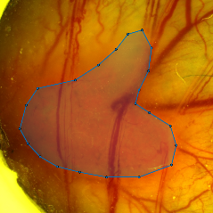
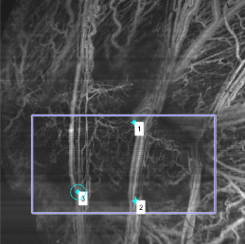
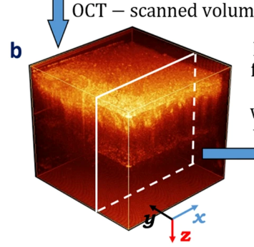
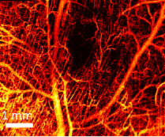
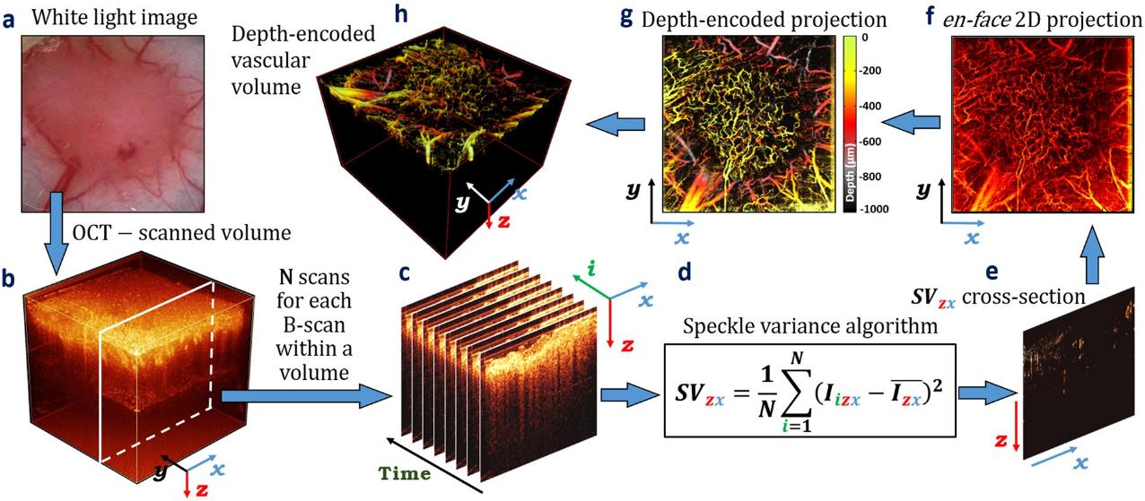
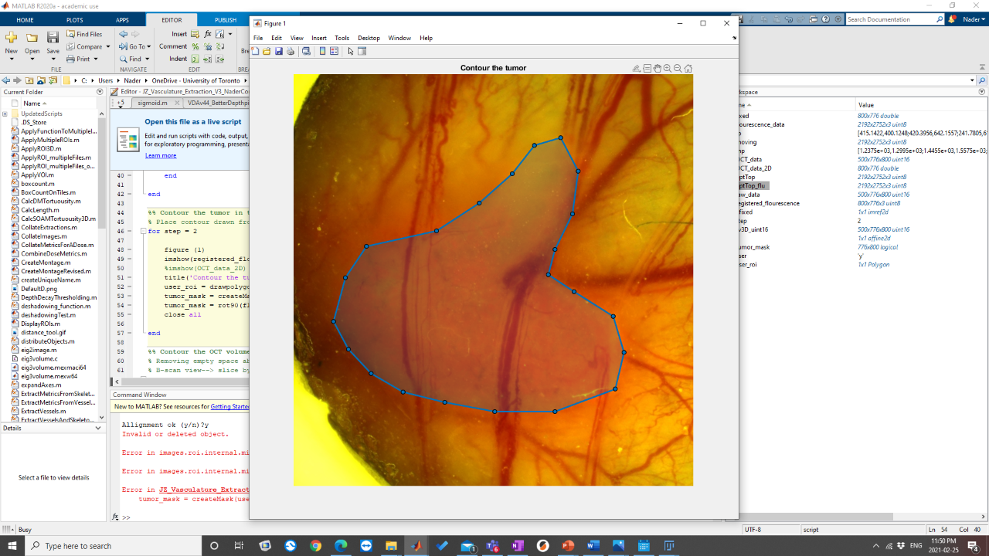
















Creating a TP^{x} 3D tumour mask
Nader Allam
$$=1mm$$
Brightfield
Fluorescence
Tumour contouring, axially via stOCT
Top
Window:
2D Co-registration
svOCT
Tissue:
(From TP⁰⁻)
Bottom: project down to a fixed depth ~650$μm$
Aligned target image for tumour contouring, en-face
$6$mm
$6$mm
3D Co-registration TPx to TP0-
$6$mm
$6$mm
6
$2.25$mm
$2.25$mm
Pre-processed OCT derived vascular map
Notes:
Very rough contour segmenting based on white light or
Affine transform (not only rigid
Do not over explain! Especially the tree
Rigid transform no scaling since same FOV (not affine non-similarity allowing scaling)

Slide 7

Nader Allam

Slide 8

Nader Allam

Slide 9

Nader Allam
TP^{x}
TP⁰⁻

Slide 10




Longitudinal optical images analysis algorithm: speed and standardization
Nader Allam
2D lateral mask creation and co-registration;
Quantification of fluorescence intensity and approximate volume;
3D co-registration of OCT scans inter-timepoints ;
3D tumour mask creation.
3D vascular segmentation (manual for now)
< 25-30min
Pre-requisite for:
Adaptive RTx experiments
Inter-modality comparison (especially immunohistochemistry)
Time series analysis
SBRT march-June 2021 study:
Method shows promise
10
Semi-automatic 2D lateral mask creation and co-registration from brightfield and fluorescence images
Quantification of fluorescence intensity and approximate volume;
3D co-registration of OCT scans inter-timepoints ;
3D tumour mask creation.
3D vascular segmentation (manual for now)
Mask creation slides after this
At the end show window chamber improvements to protect against perturbation
All this after Dlf work when I mention potential issues
Notes:
All important towards being able to eventually acquire a lot of data and have it inter-comparable and possibly when we will start adapting treatment inter-fraction (process data within the hour prior to irradiation)

Slide 11
Consistency of caliper to stOCT + brightfield/fluorescence semi-auto methods
Nader Allam
3x12Gy mice
Control mice
Algorithm and DAQ by Allam N, implementation by van der Pol L
BxPC3 tumours in DSWC

Slide 12
Tissue masking algorithm overview
TP⁰⁻: Reference timepoint
Nader Allam
TP^{x}: Other timepoints
glass_1_Tissue_2_both_3_contour
Contouring of:
1) DSWC window, 2) tissue or 3) both
TP⁰⁻: Reference timepoint
OnlyTissueLabelTimepoint0
Tissue contour for
0) each individual timepoint
1) All base off timepoint 0
TP^{x}: Other timepoints
glass_1_Tissue_2_both_3_contour
1
3
2
DSWC removal (rotate to exclude window)
Co-register all TP^{x} to TP⁰⁻ both lateral and in depth*
OnlyTissueLabelTimepoint0
OnlyTissueLabelTimepoint0
0
1
0
1
Apply TP^{x} tissue mask
Co-register TP^{x} OCT scan volume to TP⁰⁻ laterally
Co-register TP^{x} laterally
Apply TP⁰⁻ tissue mask
DSWC removal
Apply TP^{x} tissue mask
Co-register TP^{x} to TP⁰⁻ *
DSWC removal
Co-register TP^{x} to TP⁰⁻
Apply TP⁰⁻ tissue mask
tissue mask not co-registered in depth
*: For easier timeseries neural network training
Just tissue contour (no rotations to exclude glass and no co-registration in depth to timepoint 0) and lateral coregister to timepoint 0)
Apply TPx tissue mask to OCT scan volume
Glass removal
Co-register All to TP0*
if glass_1_Tissue_2_both_3_contour==3
%% Loading glass removed files
%loading of glass removed struct, raw and bin here
load(fullfile(saveFolder{1},'RawStruct_UnCoregTime0-_RotShift.mat'));%,'StOCT_UnCoregT0_RotatedShifted','-v7.3');
load(fullfile(saveFolder{1},'RawVess_UnCoregTime0-_RotShift.mat'));%,'RawOCTA_UnCoregT0_RotatedShifted','-v7.3');
if BinVesselsApplicable==1
load(fullfile(saveFolder{1},'BinVess_UnCoregTime0-_RotShift.mat'));%,'BinOCTA_UnCoregT0_RotatedShifted','-v7.3');
end
end%previously deleted for memory
Glass removal + tissue contour
Glass removal
Apply TPx tissue mask to OCT scan volume
Co-register to TP0

Slide 13


Tissue masking algorithm overview
TP⁰⁻: Reference timepoint
Nader Allam
TP^{x}: Other timepoints
glass_1_Tissue_2_both_3_contour
Contouring of:
1) DSWC window, 2) tissue or 3) both
TP⁰⁻: Reference timepoint
OnlyTissueLabelTimepoint0
Tissue contour for
0) each individual timepoint
1) All base off timepoint 0
TP^{x}: Other timepoints
glass_1_Tissue_2_both_3_contour
1
3
2
DSWC removal (rotate to exclude window)
Co-register all TP^{x} to TP⁰⁻ both lateral and in depth*
OnlyTissueLabelTimepoint0
OnlyTissueLabelTimepoint0
0
1
0
1
Apply TP^{x} tissue mask
Co-register TP^{x} OCT scan volume to TP⁰⁻ laterally
Co-register TP^{x} laterally
Apply TP⁰⁻ tissue mask
DSWC removal
Apply TP^{x} tissue mask
Co-register TP^{x} to TP⁰⁻ *
DSWC removal
Co-register TP^{x} to TP⁰⁻
Apply TP⁰⁻ tissue mask
tissue mask not co-registered in depth
*: For easier timeseries neural network training

Slide 14

Next steps

Slide 15
Tissue masking algorithm overview (next step)
Nader Allam
glass_1_Tissue_2_both_3_contour
Contouring of:
1) DSWC window, 2) tissue or 3) both
TP⁰⁻: Reference timepoint
OnlyTissueLabelTimepoint0
Tissue contour for
0) each individual timepoint
1) All base off timepoint 0
TP^{x}: Other timepoints
glass_1_Tissue_2_both_3_contour
1
3
2
DSWC removal (rotate to exclude window)
Co-register all TP^{x} to TP⁰⁻ both lateral and in depth*
OnlyTissueLabelTimepoint0
OnlyTissueLabelTimepoint0
0
1
0
1
Co-register TP^{x} OCT scan volume to TP⁰⁻ laterally
Apply TP^{x} tissue mask
Co-register TP^{x} laterally
Apply TP⁰⁻ tissue mask
DSWC removal
Co-register TP^{x} to TP⁰⁻ *
Apply TP^{x} tissue mask
DSWC removal
Co-register TP^{x} to TP⁰⁻
Apply TP⁰⁻ tissue mask
(To help assess quality of TP^{x} mask during creation)
tissue mask not co-registered in depth
*: For easier timeseries neural network training
Just tissue contour (no rotations to exclude glass and no co-registration in depth to timepoint 0) and lateral coregister to timepoint 0)
Apply TPx tissue mask to OCT scan volume
Glass removal
Co-register All to TP0*
if glass_1_Tissue_2_both_3_contour==3
%% Loading glass removed files
%loading of glass removed struct, raw and bin here
load(fullfile(saveFolder{1},'RawStruct_UnCoregTime0-_RotShift.mat'));%,'StOCT_UnCoregT0_RotatedShifted','-v7.3');
load(fullfile(saveFolder{1},'RawVess_UnCoregTime0-_RotShift.mat'));%,'RawOCTA_UnCoregT0_RotatedShifted','-v7.3');
if BinVesselsApplicable==1
load(fullfile(saveFolder{1},'BinVess_UnCoregTime0-_RotShift.mat'));%,'BinOCTA_UnCoregT0_RotatedShifted','-v7.3');
end
end%previously deleted for memory
Glass removal + tissue contour
Glass removal
Apply TPx tissue mask to OCT scan volume
Co-register to TP0

Slide 16




Automatic glass delineation and inter-frame co-registration
Nader Allam
x, width [pix]
$$θ$$
$$ρ=x \cos\left(θ\right)+z\sin\left(θ\right)$$
In practice
z, depth [pix]
Edge filtering & binarization
Thresholding and superposition
(DSWC window line detection)
$$θ [°]$$

Slide 17

Nader Allam

Slide 18
Automatic Vessel segmentation pipeline with accuracy quantification
Nader Allam
Regions of ↓SNR
$$D_{thres}=cot⁡(α_{thres}) ⋅ iSNR$$
$D≡Complex Decorrelation$
$iSNR≡\frac{σ_{noise}^{2}}{Intensity}$
Zhang Y et al. “Automatic 3D adaptive vessel segmentation based on linear relationship between intensity and complex-decorrelation in optical coherence tomography angiography”. Quant Imaging Med Surg. (2021)
Goal: Fit $α_{thres}$ to plot of ID space (iSNR-D) per B-scan
BISIM quantifies confidence in $α_{thres}$
Notes:
$a.s.$→ asymptotically (with probability of convergence 1)
$D_{thres}$ is the value of decorrelation vs iSNR considered to be threshold between vessel and non-vessel
$α_{thres}$ is the slope fit
Need small enough VOI to be locally adaptive but also large enough

Slide 19



Automatic Vessel segmentation pipeline with accuracy quantification
From Huang et al. :${ D}_{static}→iSNR, a.s.$ & $σ_{D}=c_{D}\overline{{ D}_{static}}$
$D≡Complex Decorrelation$
$c_{v}≡Coefficient of variance in D$ for considered VOI
$c_{v}∝\frac{1}{Vol of VOI}$
$iSNR≡\frac{σ_{noise}^{2}}{Intensity}$
Fit $α_{thres}$
per B-scan*
$D_{thres}=cot⁡(α_{thres}) ⋅ iSNR$
BISIM quantifies confidence in $α_{thres}$
Regions of ↓SNR
to plot of ID space (iSNR-D)
Zhang Y et al. “Automatic 3D adaptive vessel segmentation based on linear relationship between intensity and complex-decorrelation in optical coherence tomography angiography”. Quant Imaging Med Surg. (2021)
*Later at multiple 2D ROIs per y-step
19
Huang et al. “SNR-Adaptive OCT Angiography Enabled by Statistical Characterization of Intensity and Decorrelation With Multi-Variate Time Series Model”. IEEE Trans Med Imaging. (2019)
Notes:
$a.s.$→ asymptotically (with probability of convergence 1)
$D_{thres}$ is the value of decorrelation vs iSNR considered to be threshold between vessel and non-vessel
$α_{thres}$ is the slope fit
Need small enough VOI to be locally adaptive but also large enough

Slide 20

Huang et al.

Slide 21



Processing description
Complex decorrelation OCT→ improved SNR for blood flow vs svOCT
Optimization of $α_{thres}$ per B-scan, y (iteratively)
Compute iSNR adaptive $D_{thres}$
Compute structural vectors at all (z,x) vs $α_{thres}$
Distinguish classes of motion through minimization of BISIM($α_{1} ,α_{2}$) *:
$0°<α_{thres}≤α_{1}$, blood flow signal
$α_{1}<α_{thres}≤α_{2}$, blood flow + static tissue signal
$α_{2}<α_{thres}≤90°$, blood flow + static tissue + noise signal
*Intra-class variation should be minimal
Zhang Y et al. “Automatic 3D adaptive vessel segmentation based on linear relationship between intensity and complex-decorrelation in optical coherence tomography angiography”. Quant Imaging Med Surg. (2021)
Nam AS et al. “Complex differential variance algorithm for optical coherence tomography angiography.” Biomed Opt Express. (2014)
21

Slide 22


Slide 23





CDV-OCT vs SV-OCT
$$I\left(z,x,y,t\right)≡{sig}_{Re}+i∙{sig}_{Im}$$
$$CDV\left[I\left(z,x,y\right)\right] =\sqrt{1−\frac{\left(\sum_{t=1}^{M−1}{\left|\sum_{k=−L}^{L}{w\left(k\right)I\left(z−k,x,y,t\right)I^{∗}\left(z−k,x,y,t+1\right)}\right|}\right)}{\left(\frac{1}{2}\sum_{t=1}^{M−1}{\sum_{k=−L}^{L}{w\left(k\right)({\left|I\left(z−k,x,y,t\right)\right|}^{2}+{\left|I\left(z−k,x,y,t+1\right)\right|}^{2}}}) \right)}}$$
$$sv\left[I\left(z,x,y\right)\right] =\sum_{t=1}^{N}{\frac{{\left(\overline{|I\left(z,x,y\right)|}−|I\left(z,x,y,t\right)|\right)}^{2}}{N}}$$
Notes:
complex differential variance

Slide 24




CDV-OCT M=2 vs M=8
$$I\left(z,x,y,t\right)≡{sig}_{Re}+i∙{sig}_{Im}$$
$$CDV\left[I\left(z,x,y\right)\right] =\sqrt{1−\frac{\left(\sum_{t=1}^{M−1}{\left|\sum_{k=−L}^{L}{w\left(k\right)I\left(z−k,x,y,t\right)I^{∗}\left(z−k,x,y,t+1\right)}\right|}\right)}{\left(\frac{1}{2}\sum_{t=1}^{M−1}{\sum_{k=−L}^{L}{w\left(k\right)({\left|I\left(z−k,x,y,t\right)\right|}^{2}+{\left|I\left(z−k,x,y,t+1\right)\right|}^{2}}}) \right)}}$$
Notes:
complex differential variance

Slide 25








Need for iSNR rescalling
For arbitrarily chosen B-scan:
width [mm]
iSNR distribution
“Binarized vasculature map”
0
9
Depth [mm]
Pre-rescalling
counts
ID-BISIM algorithm
width [mm]
iSNR range
2.2
0
9
Depth [mm]
Preliminary attempts at rescalling
counts
ID-BISIM algorithm
iSNR range
2.2
Notes:
iSNR was never high enough such that with different alpha will necessarily ever have threshold of D higher then D computed at given voxel even when take median to rescale alpha range

Slide 26

Notes:
With rescalling, Frame of decorthreshold related through cot of angle * iSNR value at each voxel
D3D obtains threshold from Frame of decorthreshold to give vessels

Slide 27

Notes:
With rescalling, Frame of decorthreshold related through cot of angle * iSNR value at each voxel
D3D obtains threshold from Frame of decorthreshold to give vessels

